Slide 1
AI and Analytics Powered Marketing

Slide 2
Agenda
01 Foundations
02 Marketing Today
03 Marketing Tomorrow
04 AI and Ethics

Slide 3
Where are we?
Marketing Today
A Framework for Current AI Applications

Slide 4
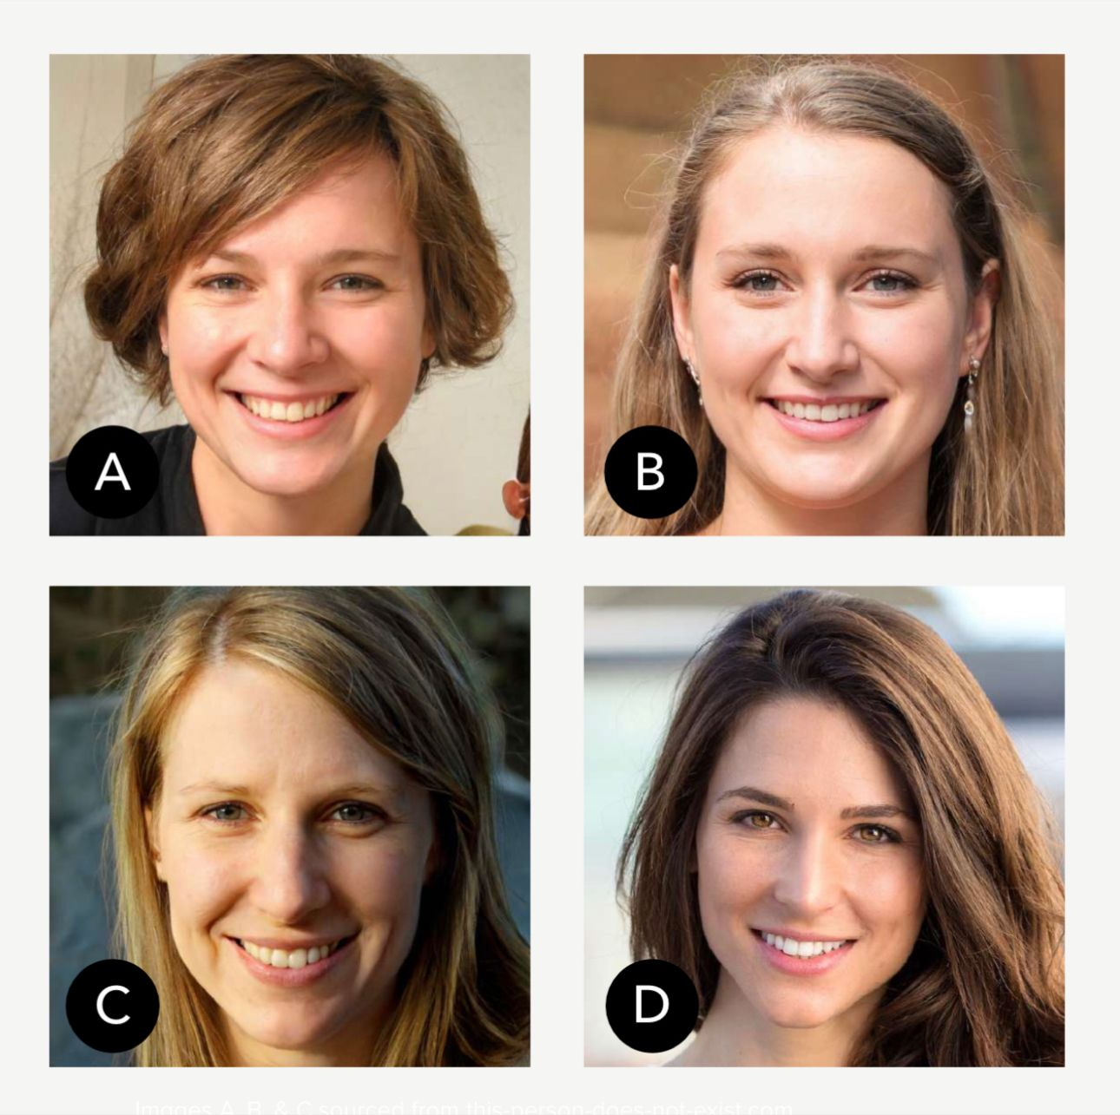
Which picture wasn't generated by AI? AI is now able to create more real pictures than humans can generate themselves
In March 2023, research by SYZYGY GROUP on 1,104 German citizens (both genders and 4 generations), only 8% of respondents answered correctly (random would be 25%).
What are the implications for firms? Consumers?
Notes:
AI influencers? --> Impact on mental health? More positive or more negative?

Slide 5
Marketing AI can be Categorized According to Two Dimensions: Intelligence Level & Integration Level
Intelligence
Integration
Task Automation
Repetitive, structured tasks that require relatively low levels of intelligence
Email newsletters
A special trip is required to interact with AI
Stand-alone Applications
Clearly demarcated AI programs. Not on employees’ and customers’ path in engaging with the brand
Simple chatbots
Visible to the consumer
Social media scheduling
Machine Learning
Complex algorithms using big data to make predictions and decisions
Programmatic Advertising
Creates efficiency and increases effectiveness of marketing operations
Integrated Applications
Embedded within existing systems, less visible than the stand-alone apps
E-commerce Recommendation Engines
AI-based lead scoring system in Salesforce CRM platform
Sales Propensity Models (CRM)
Source: How to Design an AI Marketing Strategy, Harvard Business Review, July-August 2021
Notes:
HBR, AI Powered Marketing Spotlight Series

Slide 6
The Four Kinds of Marketing AI
Stand-alone
Machine-Learning Apps
Integrated
Machine-Learning Apps
Understanding the potential AI applications according to the Framework helps with the rollout of the marketing AI.
Sephora Virtual Artist
Behr color-discovery app
Chat GPT
Predictive sales-lead scoring CRM-based sales coaching
E-commerce product recommendations
Programmatic digital ad buying
MORE ADVANCED
Stand-alone
Task Automation Apps
Integrated
Task Automation Apps
Easier to set up, limited benefits
LESS ADVANCED
Basic consumer service chatbots (such as Facebook and Messenger bots)
Email newsletters
Inbound customer call routing
CRM-linked marketing automation systems
Needs strong AI skills and big data, most value
ISOLATED FROM
OTHER PLATFORMS
INTEGRATED INTO
OTHER PLATFORMS
1-How to Design an AI Marketing Strategy, Harvard Business Review, July-August 2021

Slide 7
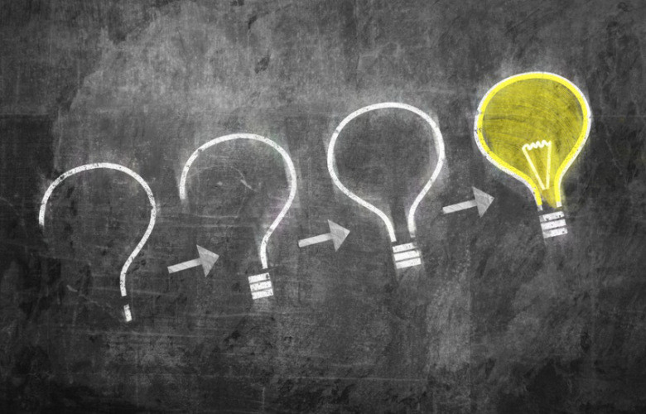
90% of Executives confirm having invested in AI
Less than 40% had seen business gains from it in the last three years¹
Why Aren’t You Getting More
from Marketing AI
1- S. Ransbotham, S. Khodabandeh, R. Fehling, B. LaFountain, D. Kiron, “Winning With AI,” MIT Sloan Management Review and Boston Consulting Group, October 2019.

Slide 8
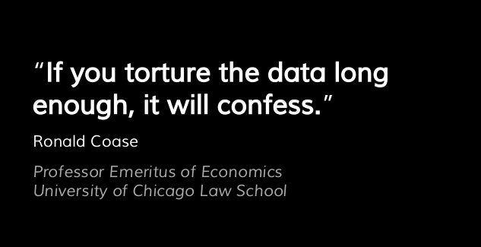
Failure to Ask the Right Questions is the First Barrier in front of AI Success Alignment
&
to anything

Slide 9
Right Question?
Not the low hanging fruit

Slide 10
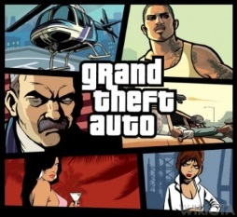
90% of Executives confirm having invested in AI
Less than 40% had seen business gains from it in the last three years¹
You are a large Telecom company and want to decrease customer churn.
Which question should your AI focus on?
Let’s do some brainstorming (aka quest for the right question)
You are a video game company and have detailed data on all players’ (e.g., sessions, length, games, levels, time).
Which question should your AI focus on?
1- S. Ransbotham, S. Khodabandeh, R. Fehling, B. LaFountain, D. Kiron, “Winning With AI,” MIT Sloan Management Review and Boston Consulting Group, October 2019.

Slide 11
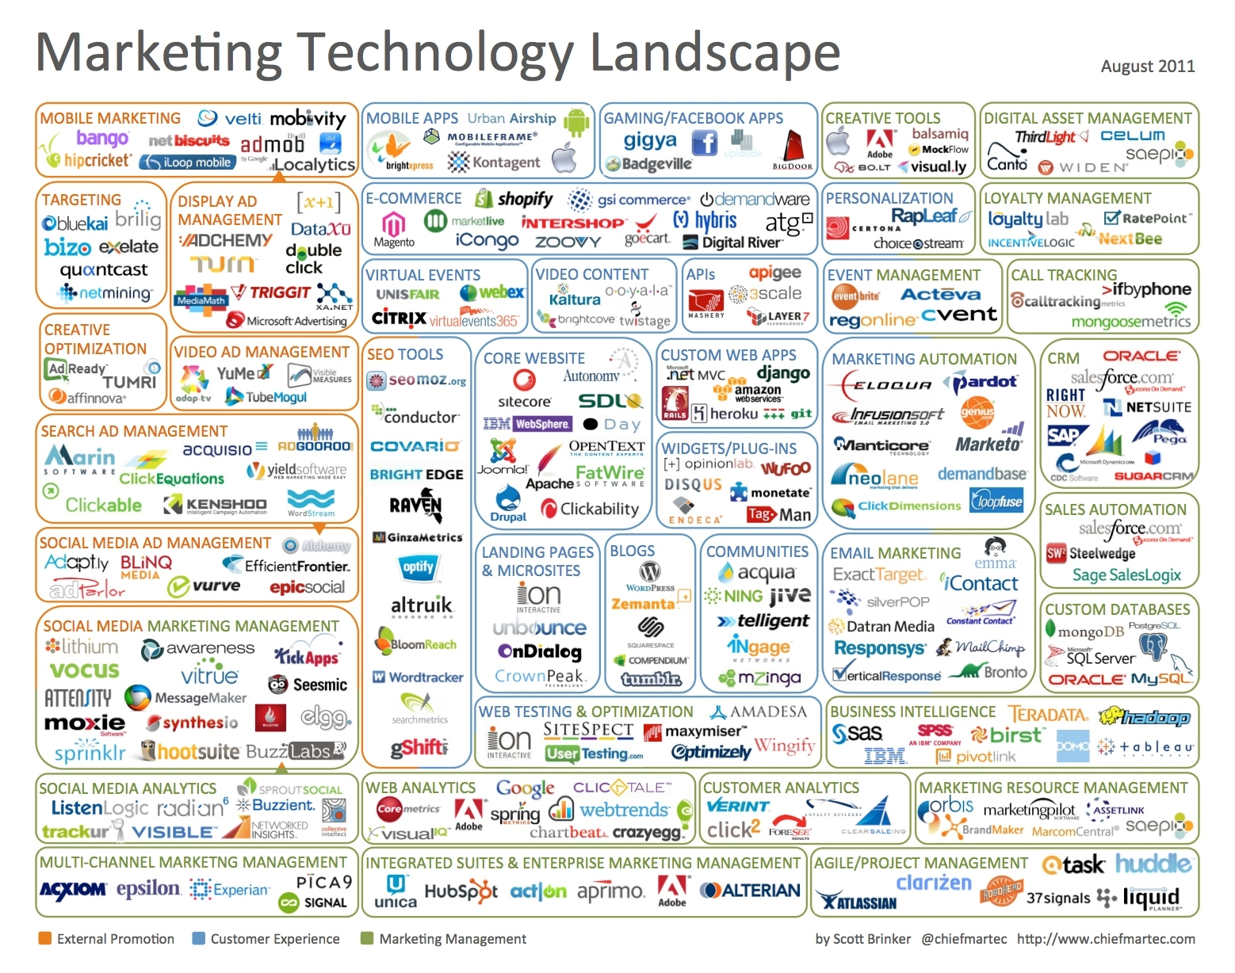
In-house or Outsource?
The Industry Evolves to Respond to the Needs
Proprietary & Confidential
Notes:
45 categories, 150 vendors

Slide 12
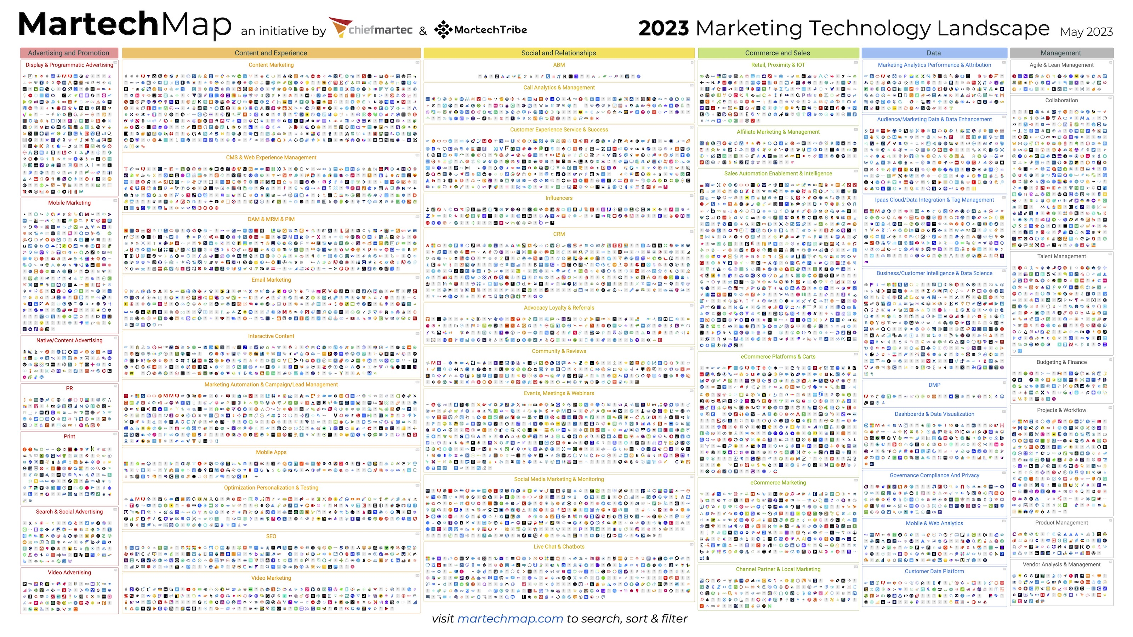
Notes:
50 categories, 11038 vendors

Slide 13
Agenda
01 Foundations
02 Marketing Today
03 Marketing Tomorrow
04 AI and Ethics

Slide 14
Where are we headed next?
Marketing Tomorrow
Marrying technology with creativity

Slide 15
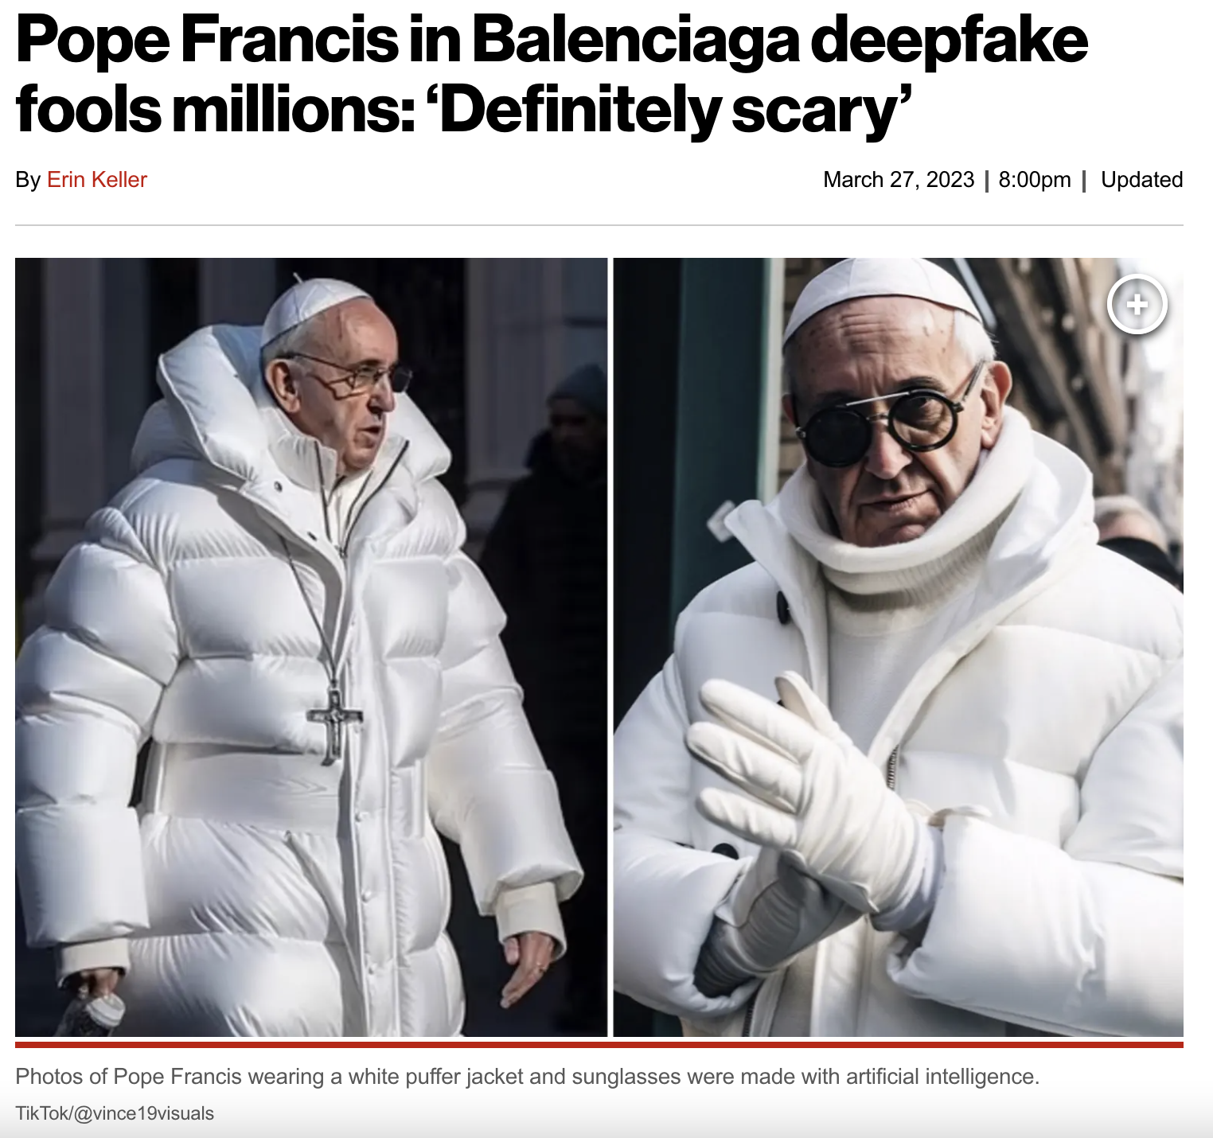
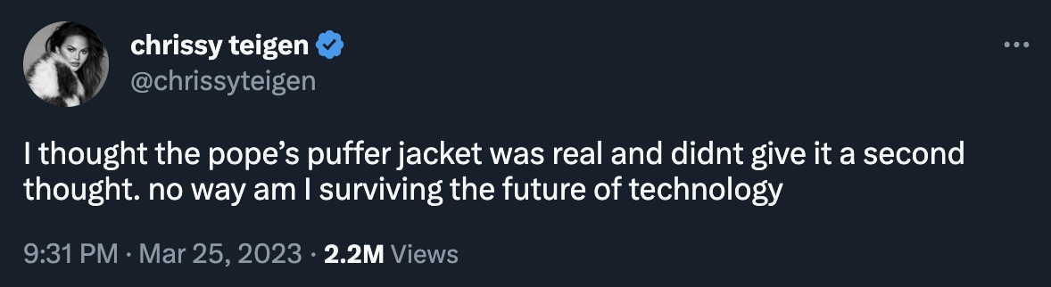
AI is moving at the speed of light. But is Marketing AI profitable for firms? Bi-focal lens (revenue generation & cost cutting)
Notes:
AI is moving at the speed of light. But is AI profitable for firms?

Slide 16
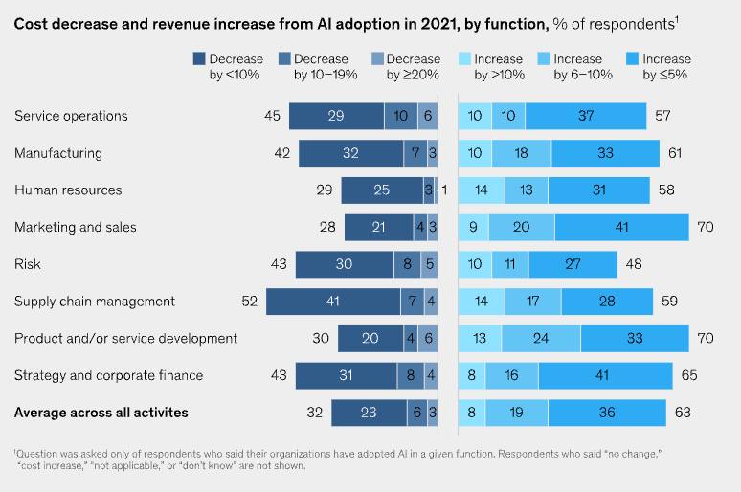
AI-related revenue increases are most often reported in product development, marketing and sales
Bottom-line value realized from AI remains consistent and strong (5% of EBIT)
Source: The State of AI in 2022 and a half decade in review, McKinsey Global Survey

Slide 17
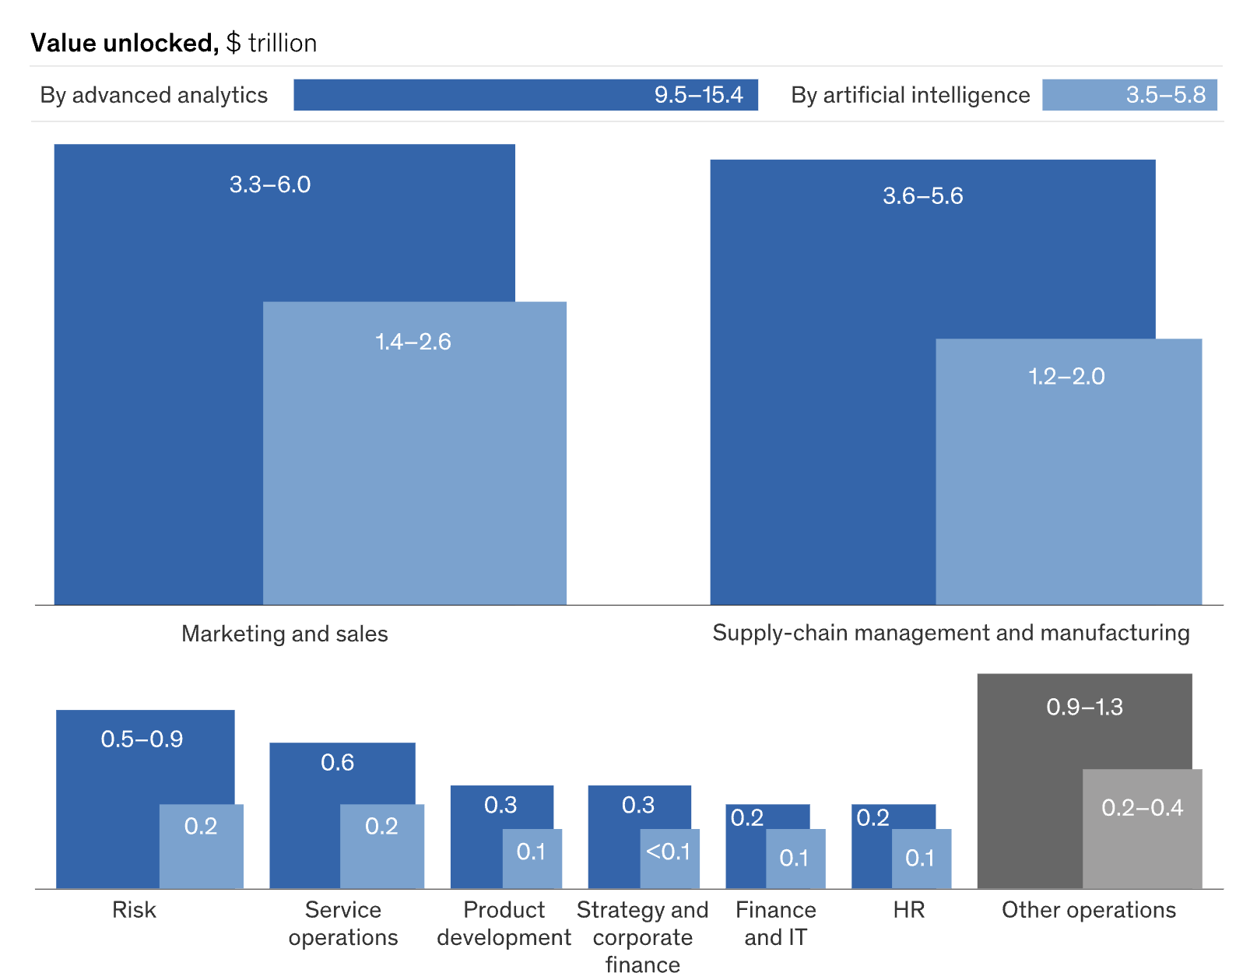
Deeper Dive into AI and Analytics-based Value Generated
Half of the $20 trillion is unlocked by marketing (at least)
Marketing’s alignment with AI disruption and value is driven by 1) impact score and 2) volume, breadth and frequency of data
Source: Most of AI’s business will be in two areas, Harvard Business Review, July 2018

Slide 18
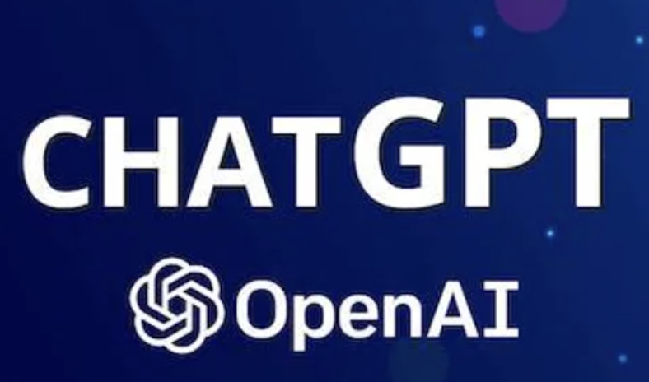
Marketing is ripe for AI-driven disruption.
Disruption: radical change to an existing industry or market due to technological innovation
Automated Forecasting & Anomaly Detection
Predictive models - churn & likelihood to convert
Automated Audience Creation & Activation
Recommendations using AI
Real Time Recommendations
Data Driven Segmentation
Data Driven Attribution - Online And Offline
Custom funnel for online + offline journeys
1:1 Personalisation Onsite
Machine Learning Customer Journey Mapping
A/B Testing practices for key audiences
Offline Data Ingestion
Self-serve analytics for all teams and departments
Advanced Media Analysis
Customer Lifetime Value Prediction
Privacy Data Management And Monitoring
Customer Segmentation
Lifetime Customer analysis and tracking
GA goals and metrics for media bidding
Content Recommendation Engine
External data injection for data-driven decisions
Virtual Reality
Custom funnel visualisation for online journeys
Content & Engagement Scoring
CRM/Loyalty Integration
Advanced online + offline Segmentation
Augmented Reality
Creative/media analytics and optimisation
Customer Journey IDs Mapping
Optimisation With Advanced Audience Targeting
GCP architecture and utilisation plan
Metaverse
Attribution Modelling
Performance Monitoring Dashboards
Blockchain
Custom funnel activation for audiences stages
Optimisation (CRO) Consultancy
Generative AI
Nascent
Automation
Integrated
Stand-alone

Slide 19
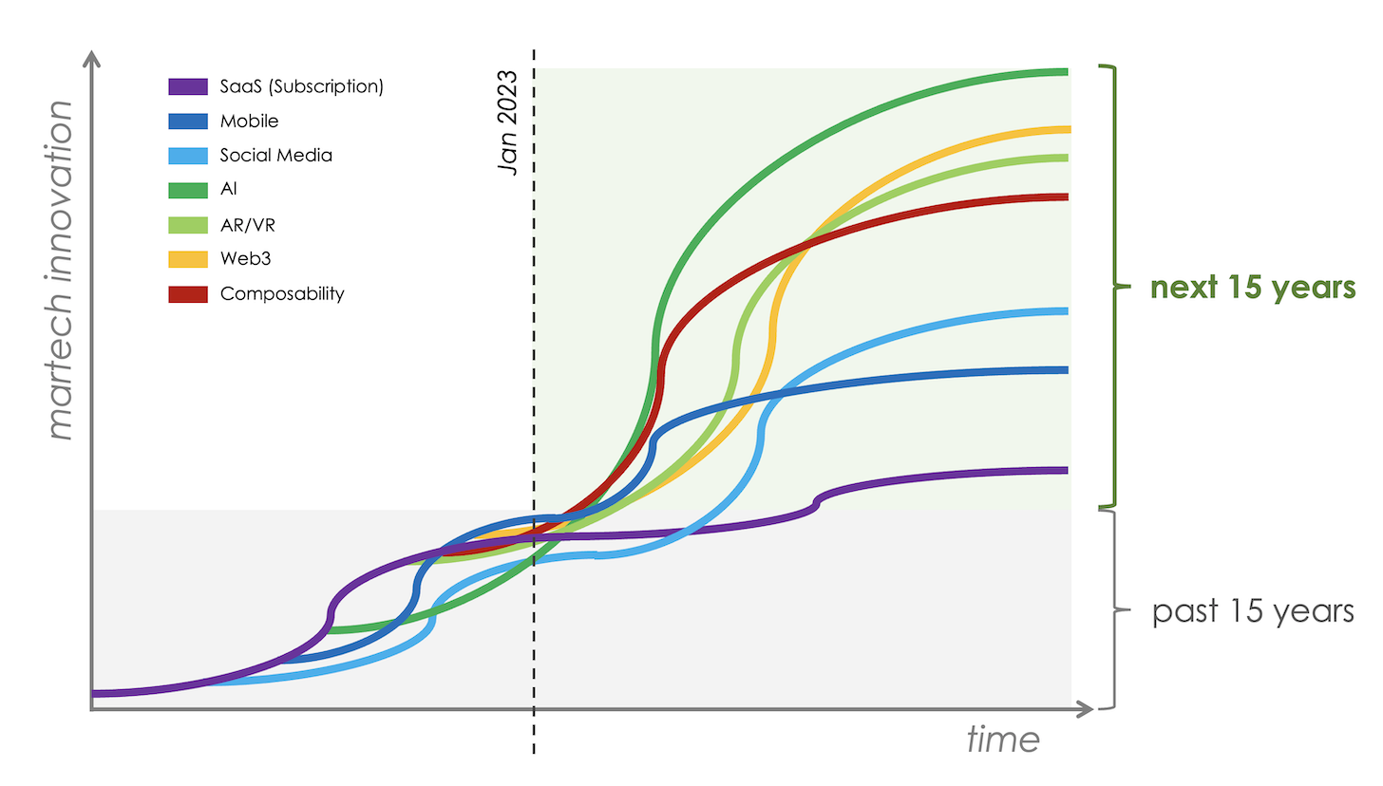
…the famous S-curve of adoption and unstoppable wave of growth
Plateauing of 3 Major technology S-curves: SaaS, Mobile, Social Media (i.e., the status quo).
Start of 4 Major technology S-curves: AI, AR/VR, Composability, Web3 (i.e., existing on the market with upward trajectories).
Source: 2023 will be a chaotic year for martech…, Scott Brinker, Chiefmartec.com
True cloud-native software + no-code interfaces

Slide 20
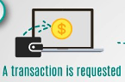
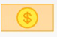
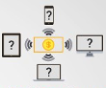
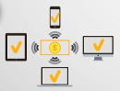

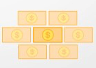

A transaction is requested
A block that represents the
transaction is created
Blockchain
The block is sent to every
node in the network
Blockchain is a technology for storing and logging transaction data. It is defined as a “digital, decentralized and distributed ledger in which transactions are logged and added in chronological order with the goal of creating permanent and tamperproof records¹”
Nodes validate the
transition
Transaction is complete
A block is added to the
existing blockchain
Nodes receive a reward
for the proof of work
1- Treiblmaier, H. (2018). The impact of the blockchain on the supply chain: a theory-based research framework and a call for action. Supply Chain Management: An International Journal.

Slide 21
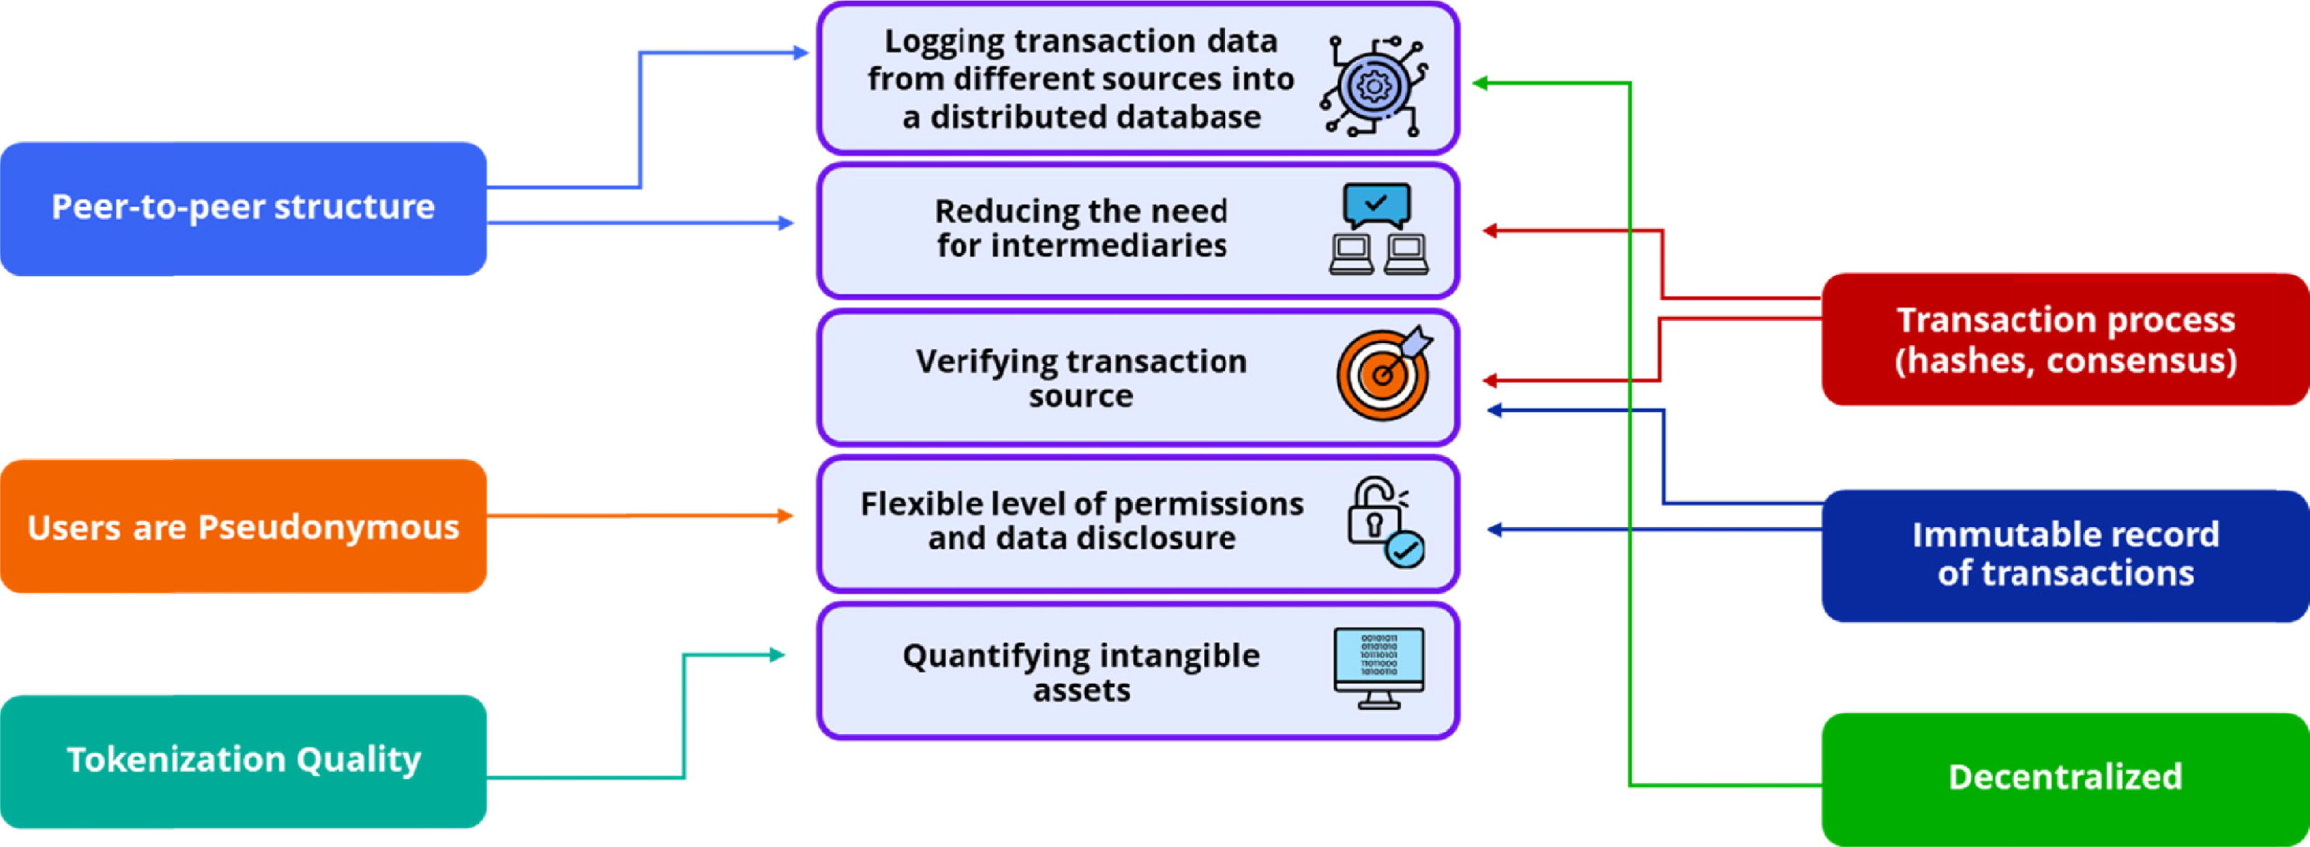
Key Benefits of Blockchain for Marketing
A blockchain enabled database can store the exposure of a customer to digital advertising on multiple devices and through multiple channels
An FMCG company can sell cleaning products directly to customers, without the need of banks, credit card companies, wholesalers, and retailers, where all relevant parties can connect, communicate, and pay directly through the blockchain
In online advertising, source verification can help to make sure that the recipients of advertising campaigns are the real target users, avoid draining one’s advertising budget
While the customer may be the owner of the data and her true identity is disguised, other parts of the data such as transaction histories or customer-firm interactions might be available to use.
Brand equity and customer equity are important firm assets that are difficult to measure and manage and so is trading them and managing their disclosure and licensing. The tokenization quality of the blockchain allows the quantification a range of intangible assets
Notes:
Schweidel, D. A., Bart, Y., Inman, J. J., Stephen, A. T., Libai, B., Andrews, M., et al (2022). How consumer digital signals are reshaping the customer journey. Journal of the Academy of Marketing Science. In press.

Slide 22
Key Benefits of Blockchain for Marketing
Data Collection and Privacy
Ad Fraud, Data Quality and Reporting
Ad Delivery, Frequency and Timing
1
2
3

Slide 23
AN EXAMPLE
BLOCKCHAIN, AD MEASUREMENT, CONSUMER PRIVACY

Slide 24
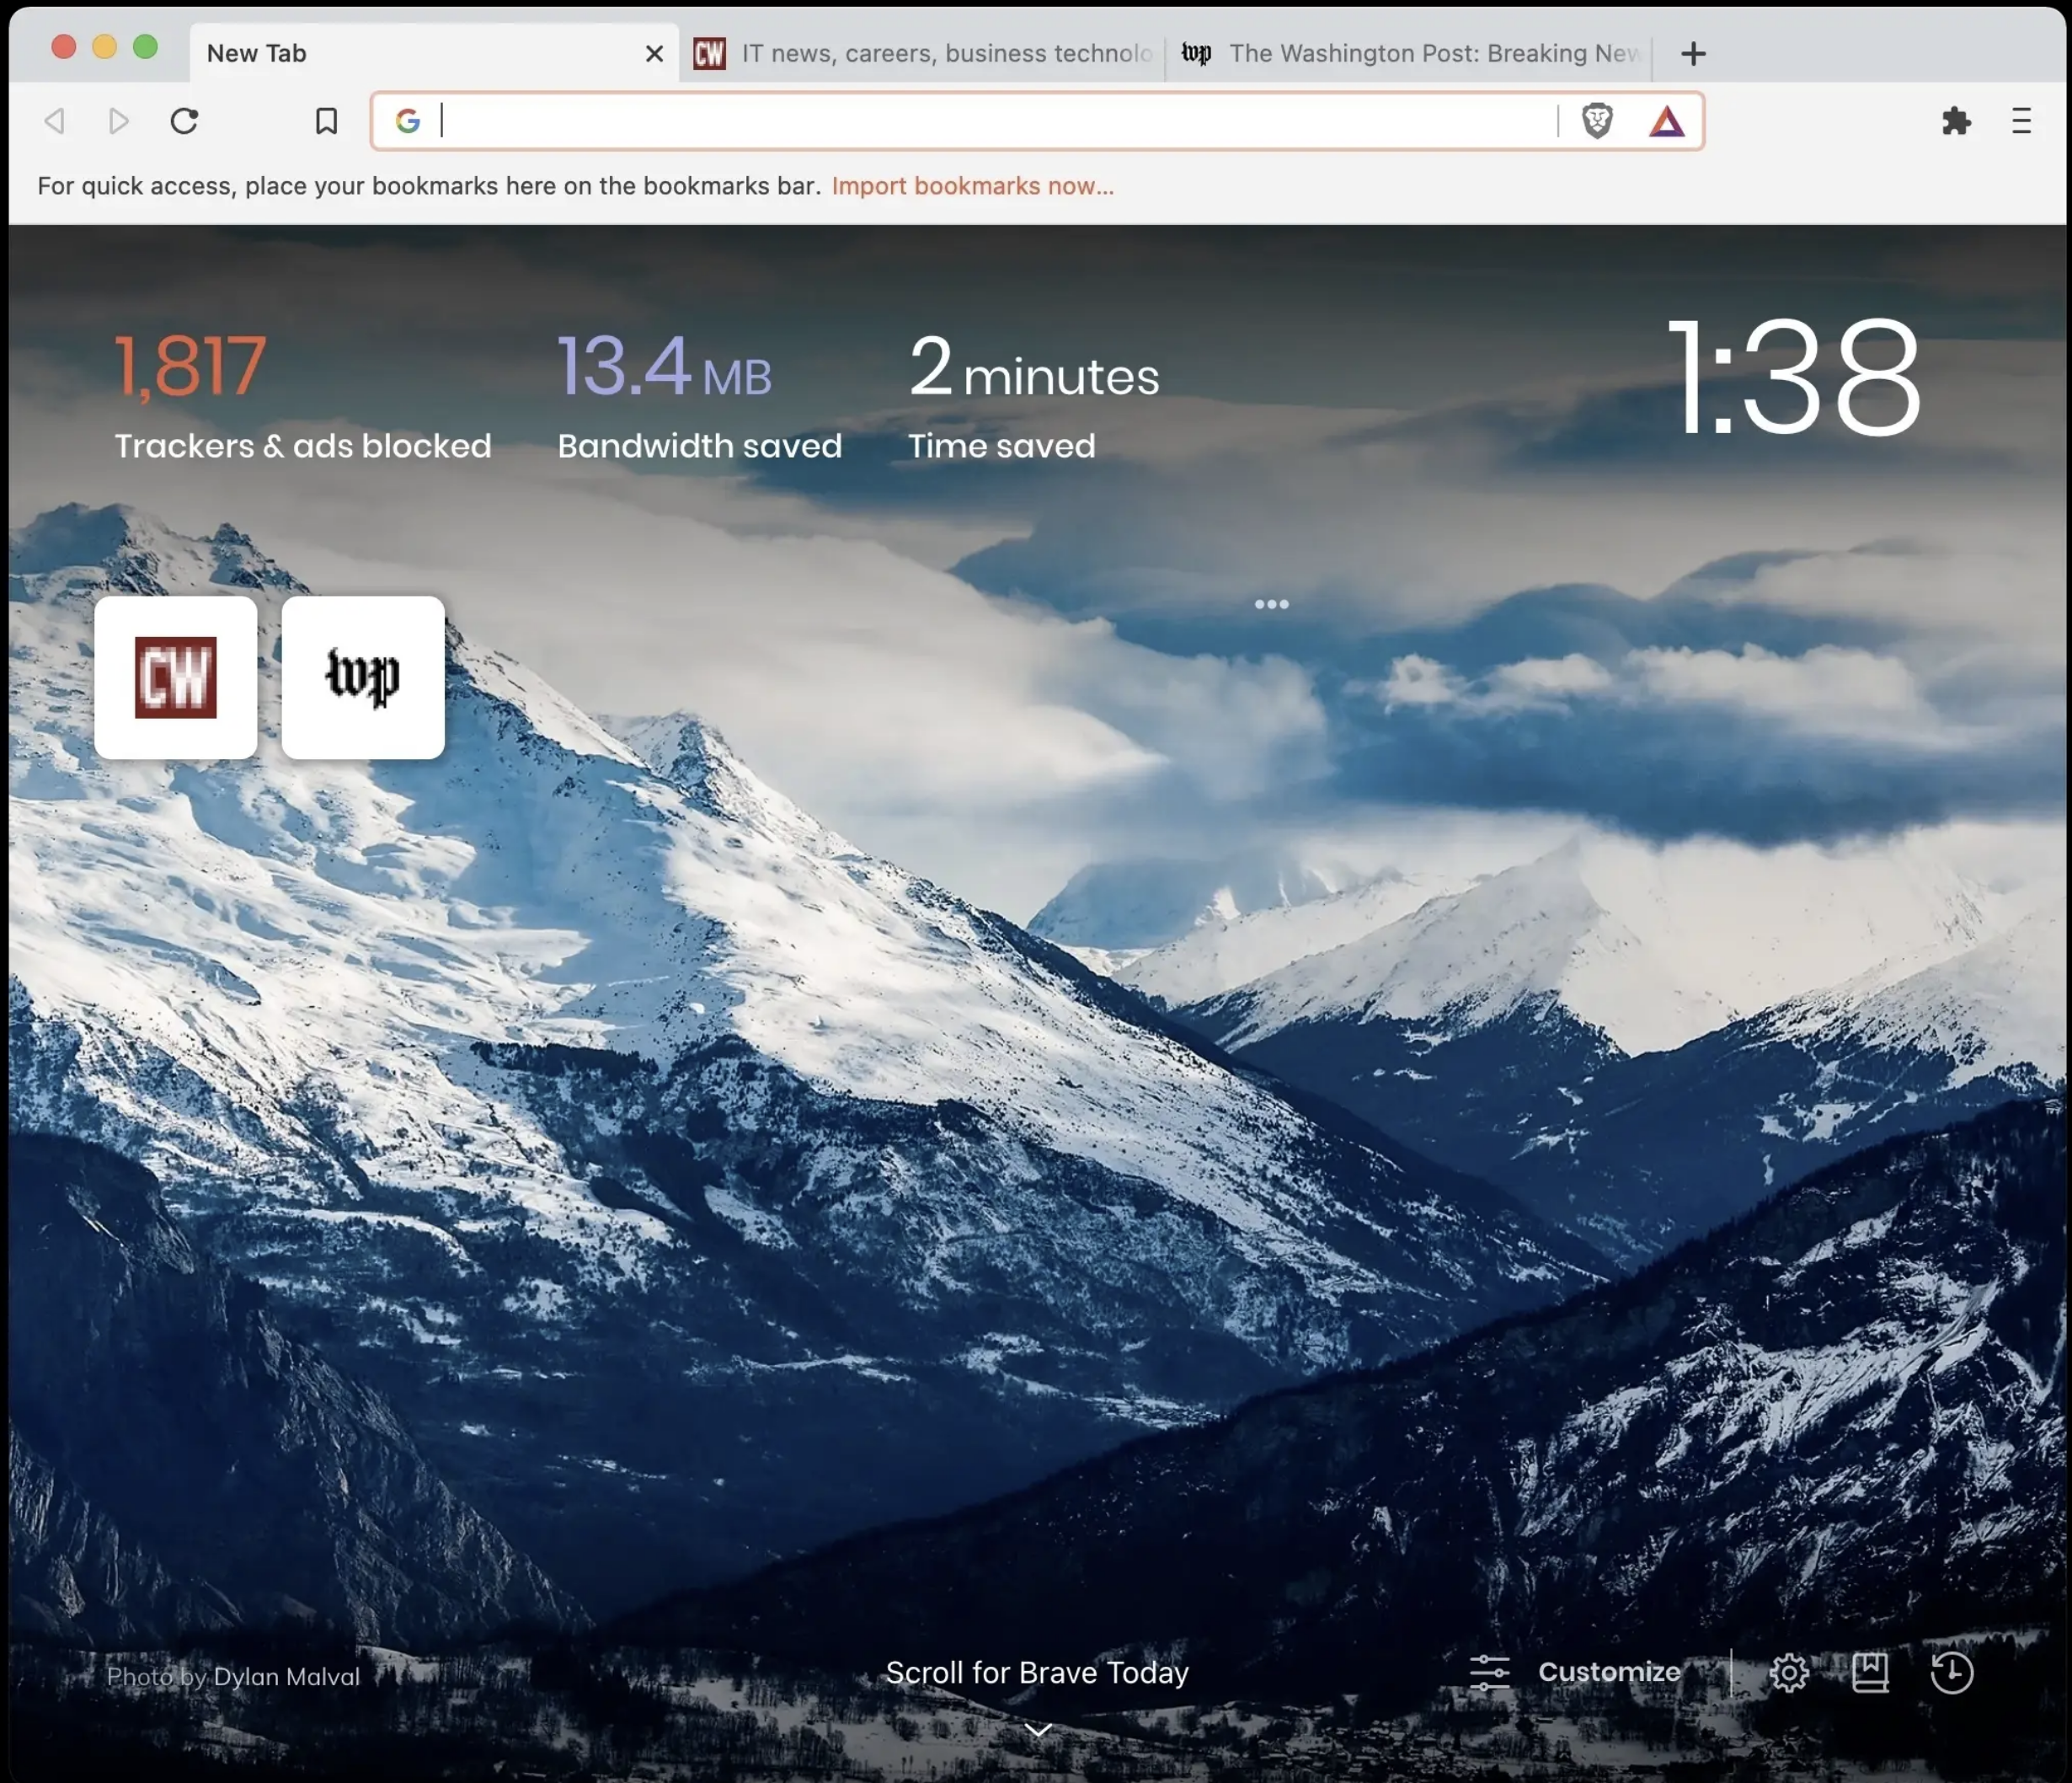

“Change is the only Constant” Heraclitus
Brendan Eich – creator of JavaScript, co-founder of Firefox founded a Blockchain startup: BRAVE

Slide 25

Brave Blockchain Browser and BAT (Basic Attention Token)
Change the way users interact with ads
Break up the current monopoly on digital advertising by allowing publishers and advertisers to trade on the value of users’ attention
Compensate users using the BAT token
Users get to choose which ads they like and opt-in to categories they like
WIN-WIN
→ Marketers get better advertising data and targeting,
publishers get better revenue and control over the ads they display
Users get fewer, better quality ads, and they get compensated for their attention and data, and their data is encrypted in the blockchain

Slide 26
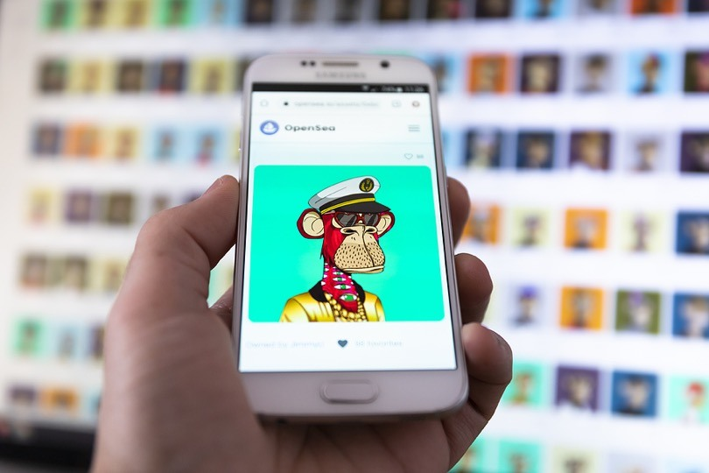
NFTs
Creating Value in The Metaverse
Digital identity has been the major driver of micro transaction revenues. However, consumers never take full ownership of their preferred identity.
Unique cryptographic assets on a blockchain
Non-fungible tokens (NFTs) have registered a whopping 17 billion USD in sales in 2021 and are on their way to beating these figures in 2022¹. OpenSea² generated $2 billion in Ethereum trading volume in just February 2022.
With NFTs brands can enter the digital space and provide consumers fully licensed clothing and cosmetics (digital wearables). This allows consumers to fully represent themselves through their digital identities.
1-McKinsey (2022). Value creation in the metaverse.
2-OpenSea: World’s largest peer-to-peer NFT marketplace

Slide 27
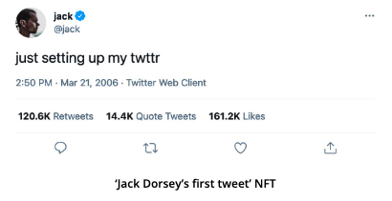
Creators “Mint” NFTs Pick your asset → Mint token → Ownership on Blockchain → Sell/Trade
Twitter founder Jack Dorsey's first ever tweet has been sold as an NFT for equivalent of $2.9m to a Malaysia-based businessman.
DIGITAL TWINNING
Create a physical copy of the digital item
These tokens might represent any kind of digital assets such as art, music, tweet, website, in-game items, or even real estate.

Slide 28
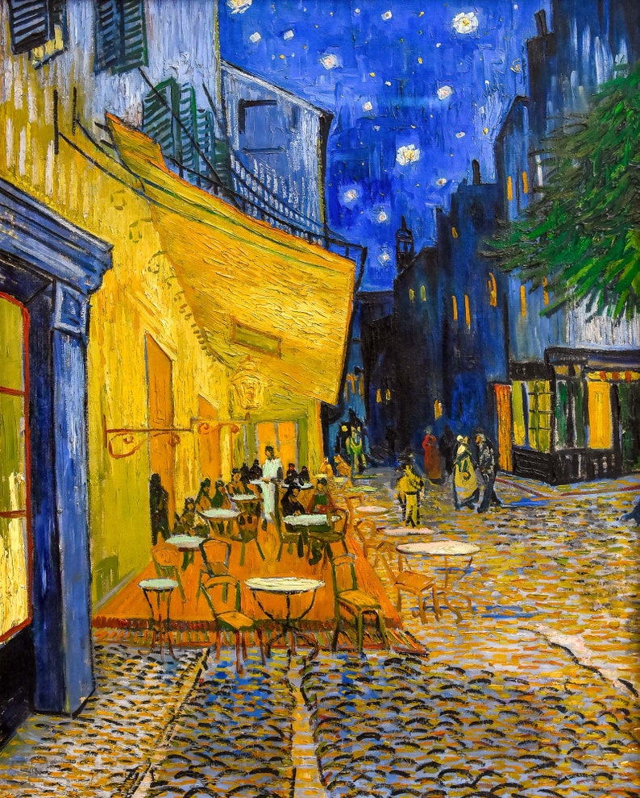
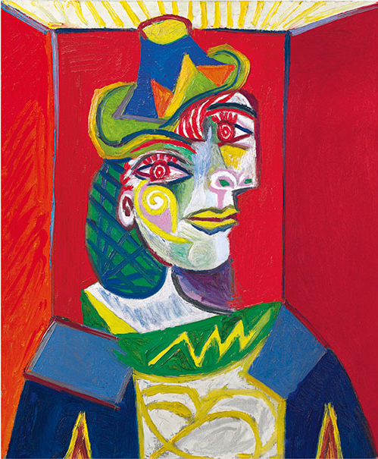
NFTs are Non-Fungible and Digital They are encrypted and have a unique hash – TRULY ONE OF A KIND

Slide 29
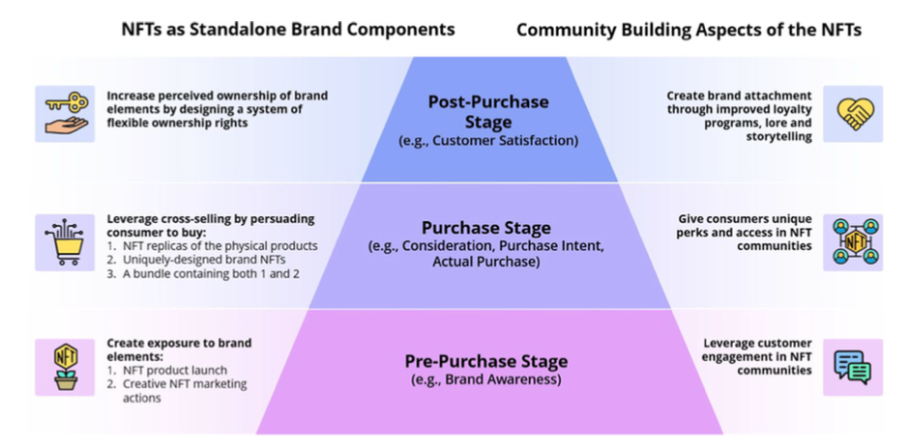
NFTs can fuel the Entire Customer Funnel The NFT hype cycle is fueled by cryptocurrency enthusiasts, Gen-Z Discord users, and a more technologically oriented crowd
Colicev, A. (2023). How can non-fungible tokens bring value to brands. International Journal of Research in Marketing.

Slide 30
NFTs can Enhance Community Building Effectiveness is higher at platforms that allow for more organic conversations between consumers, brands (e.g. Discord, Reddit, Telegram, Twitch)
.NFT Rewards Program
.collect points to access NFTs and lifetime opportunities
EXCLUSIVE CONTENT + COMMUNITY
.videos of favorite basketballs
.usable as trading cards (a unique, fun factor)
.has its very own marketplace, which more sports players are showing involvement with – to promote themselves through digital assets
.Adidas partnered with the largest OG NFT collectibles, Bored Ape Yacht Club and Punks COMIC
.complements digital experience with collaborative physical merchandise

Slide 31
NFTs Enable Self-Expression
Bridging the Gap Between Digital and the Physical World
Need a dress for a photo shoot in New York?
Your friend in Bangkok lends you one of her NFTs

Slide 32
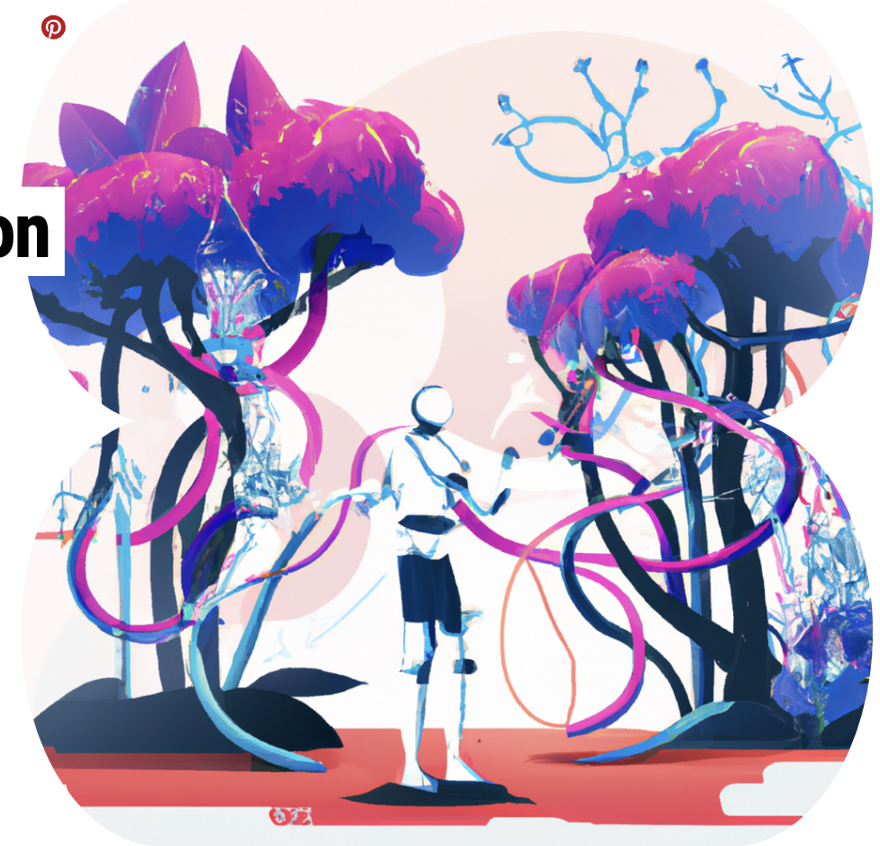
Generative AI
Generative AI can create a wide variety of data, such as images, videos, audio, text, and 3D models by learning patterns from existing data, then using this knowledge to generate new and unique outputs. GenAI is capable of producing highly realistic and complex content that mimics human creativity, making it a valuable tool for many industries such as gaming, entertainment, and product design.

Slide 33
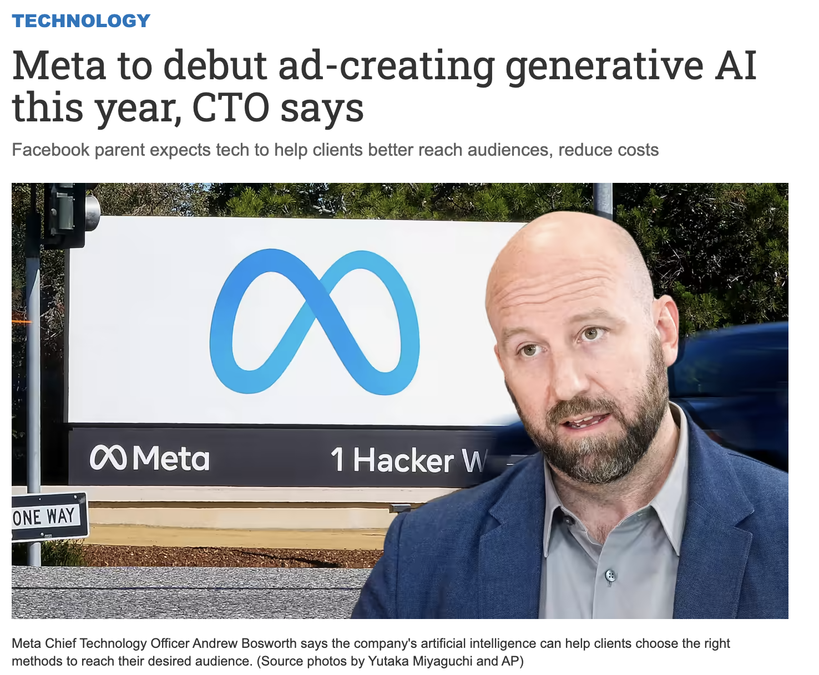
Recent Breakthroughs in GenAI Drastically
Change the Way We Approach to Content Creation

Slide 34
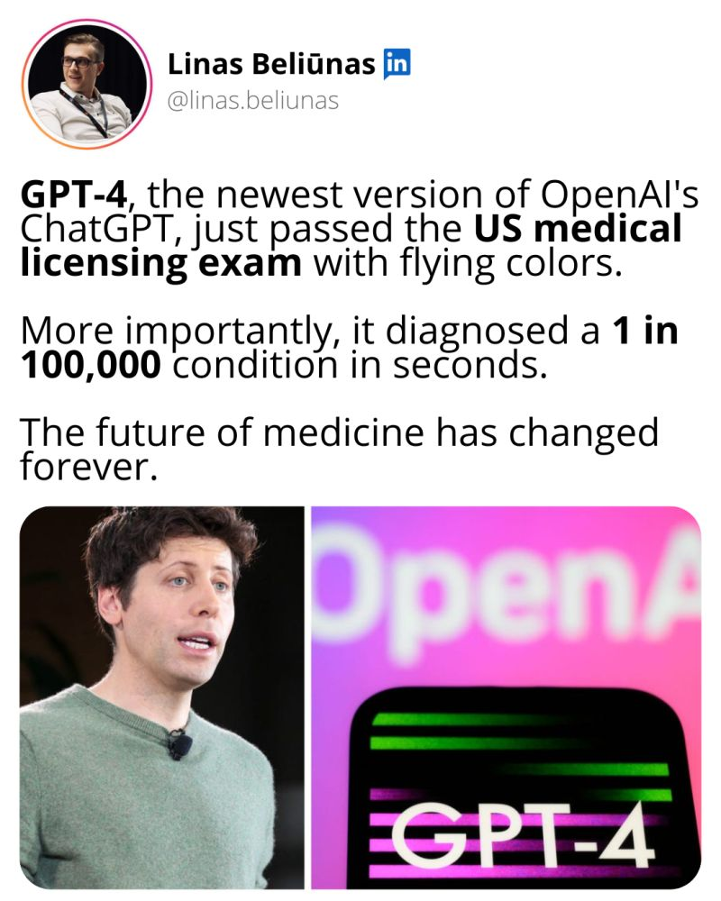

Slide 35

“I believe AR is the biggest technological revolution that happens in our lifetimes”
SOURCE: TIM SWEENEY
.Experience is 75% real, 25% virtual
.Sense of being in the real world
.Enhances both real and virtual worlds
.No special devices needed

Slide 36

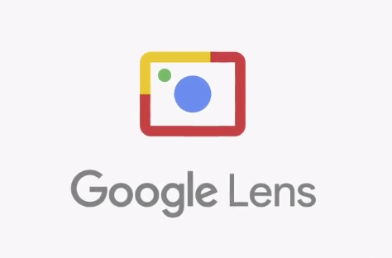
trend take
Cameras are browsers.

Slide 37
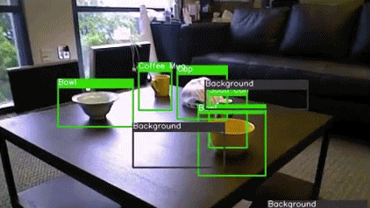
machine learning means
your brand has eyes

Slide 38
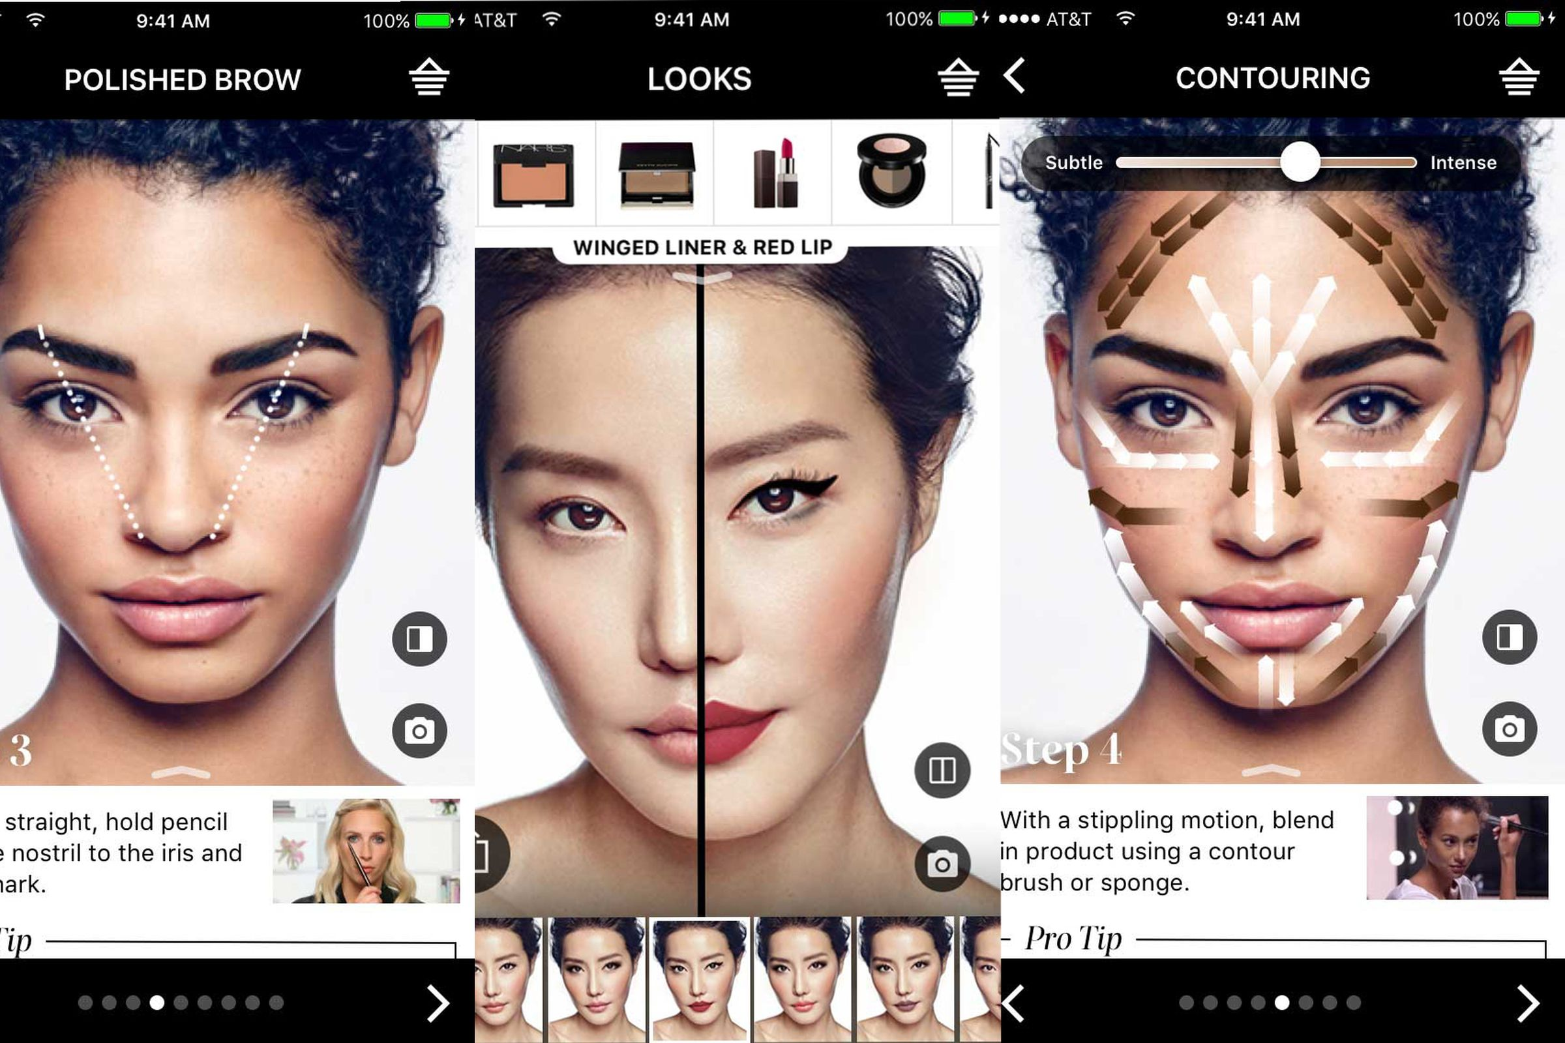
L’Oreal acquires ModiFace, a major AR beauty company
Numerous patents held for apps like Style My Hair, Nail Virtual Try On, Face Analysis.

Slide 39

IKEA Kreativ
Shop for furniture by trying it out
in your own space at your own time

Slide 40
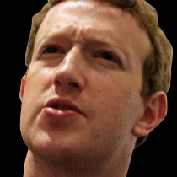
“VR is really a new communication platform. By feeling truly present, you can share unbounded spaces and experiences with the people in your life. Imagine sharing not just moments with your friends online, but entire experiences and adventures.”
SOURCE: MARK ZUCKERBERG
.Experience is 75% virtual, 25% real
.Visual senses are under the control of the system
.Enhances fictional reality
.Special devices required (e.g. gloves, headset)

Slide 41
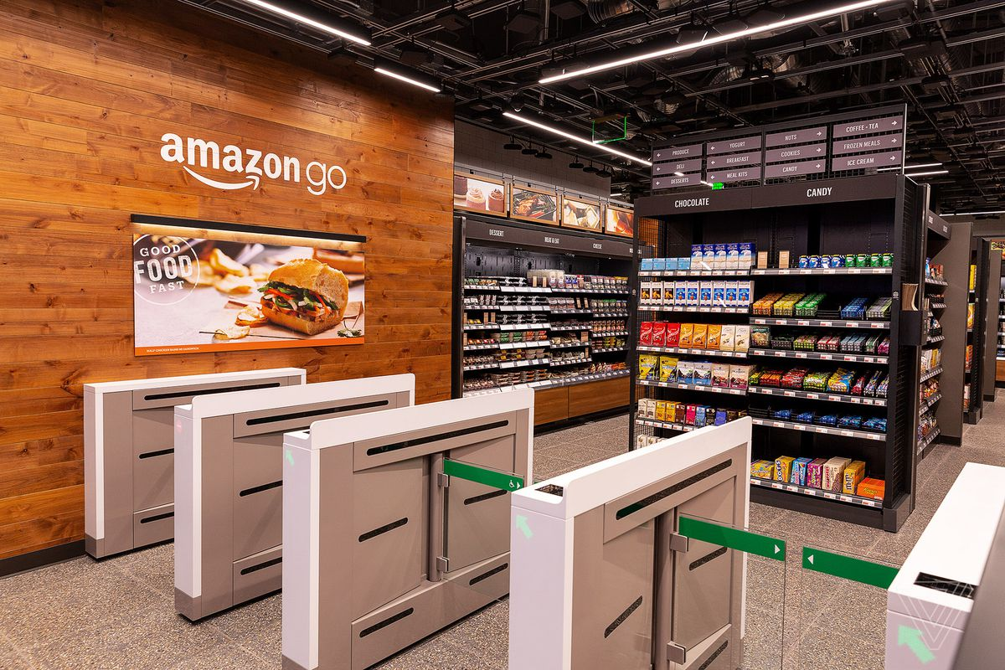
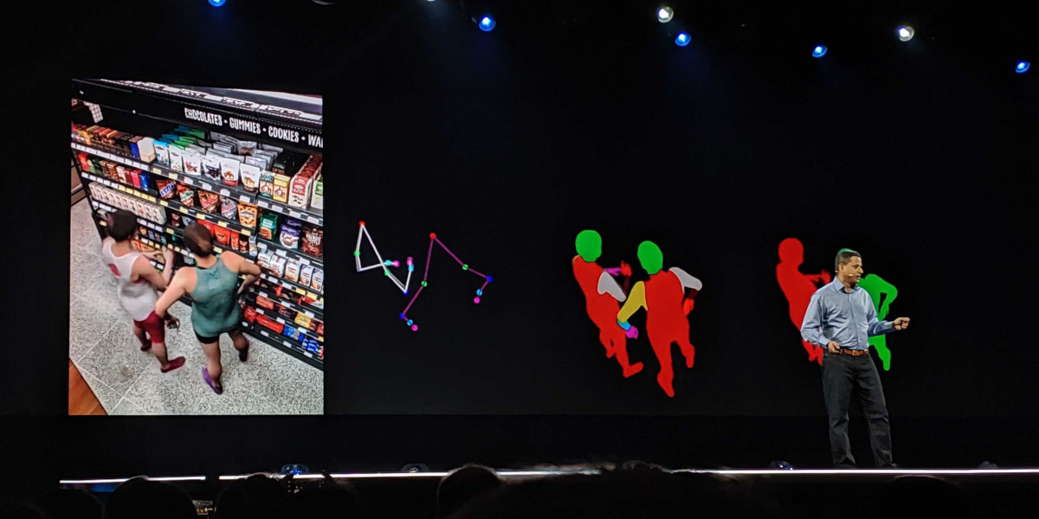
Pushing the Limits
Seamless integration of different tools & technologies
AWS, ML, RL, Simulations
“Just Walk Out”
Person detection
Sensor Fusion
Calibration
Object recognition
Activity analysis
Pose estimation

Slide 42
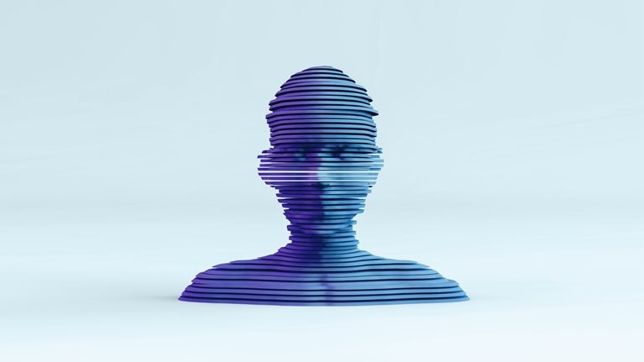
Metaverse
The metaverse is the emerging 3-D-enabled digital space that uses virtual reality, augmented reality, and other advanced internet and semiconductor technology to allow people to have lifelike personal and business experiences online.
https://www.mckinsey.com/featured-insights/mckinsey-explainers/what-is-the-metaverse

Slide 43
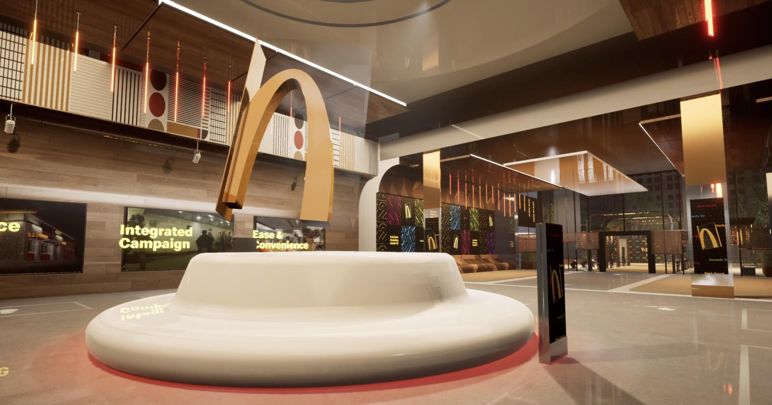
McDonald’s to open up in the Metaverse and orders to offer real-life delivery

Slide 44










When to invest in emerging tech & when to pull the plug? Disney recently pulled out of Metaverse, others are still investing
1
2
3
Diversification strategy as a new sales channel for additional source of revenue (through NFTs)
Attract new customers and avoid competitors act as first movers and dominate the space.
Generate a link between real and virtual continuum to simplify the customer experience

Slide 45
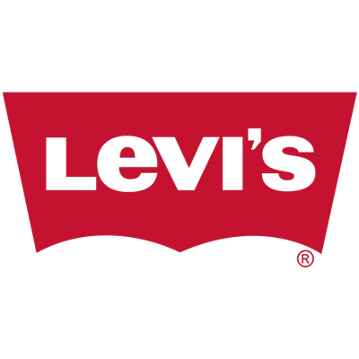
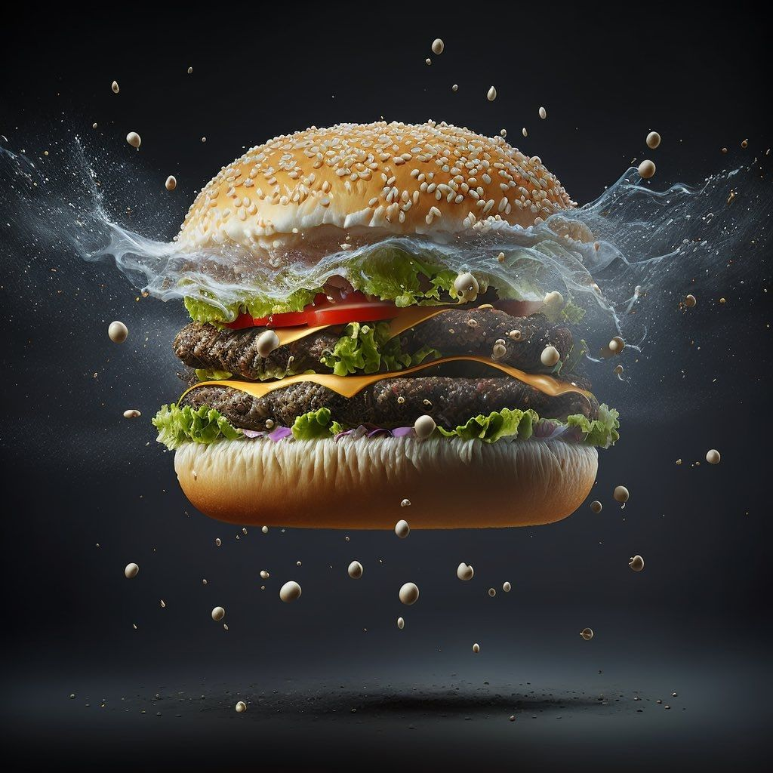
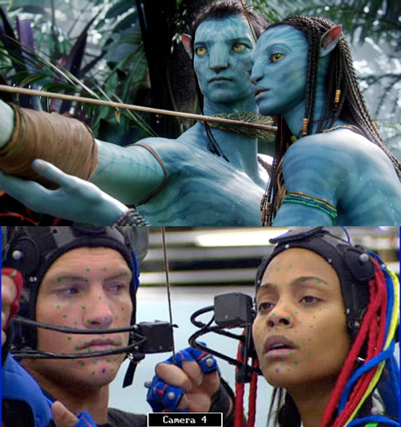

Virtual production reduce costs across industries
Marketing production is transformed entirely
Movie production without CGI
Fashion world is being disrupted
AI Models are “more human than human”
No more food photographers, no more sets, no more constraints

Slide 46

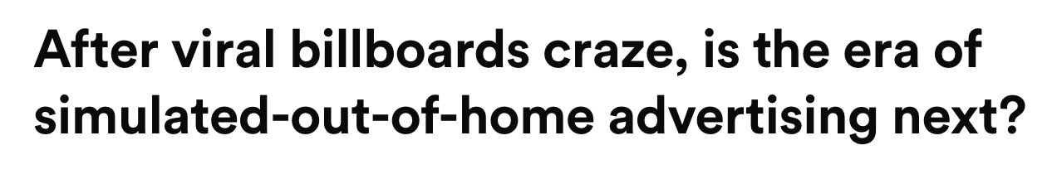

“Anything that is part of a human experience is actually real. Does it matter whether they are tangible or not? They leave an impact, an impression, form memory and taste, and whatever they have left becomes part of the individuals who have witnessed it.” (Andrés Reisinger).
Notes:
Picasso – Everything you can imagine is real

Slide 47

The Marketing Holy Grail
Right Message
Right Person
Right Moment
Marketing Success

Slide 48
THE RIGHT PARADIGM
(Human AND AI)

Slide 49
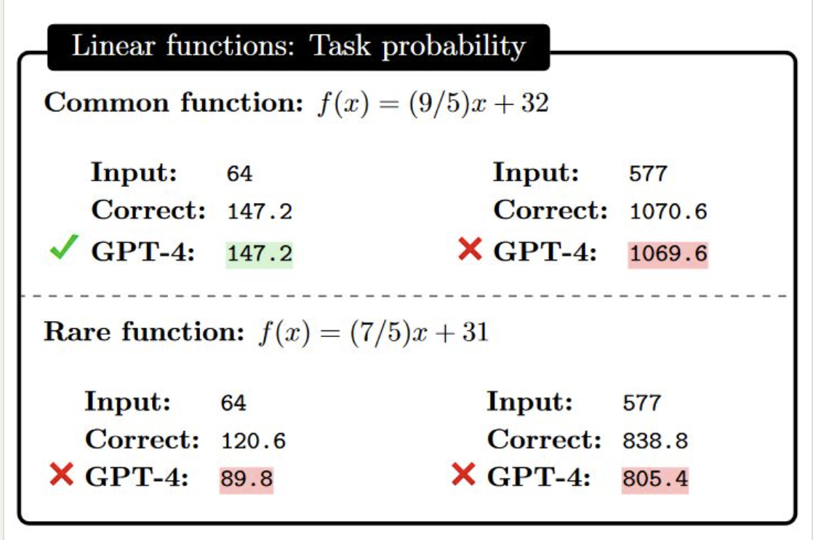
The Curious Ways LLMs Systematically Fail to Guide Us
GPT4 does not know how to perform tasks (e.g., solve linear equations) as such. Instead, it is able to provide answers that may or may not be correct, to the extent that occurrences of the same problems are featured in the training data.
1-https://arxiv.org/pdf/2309.13638.pdf

Slide 50
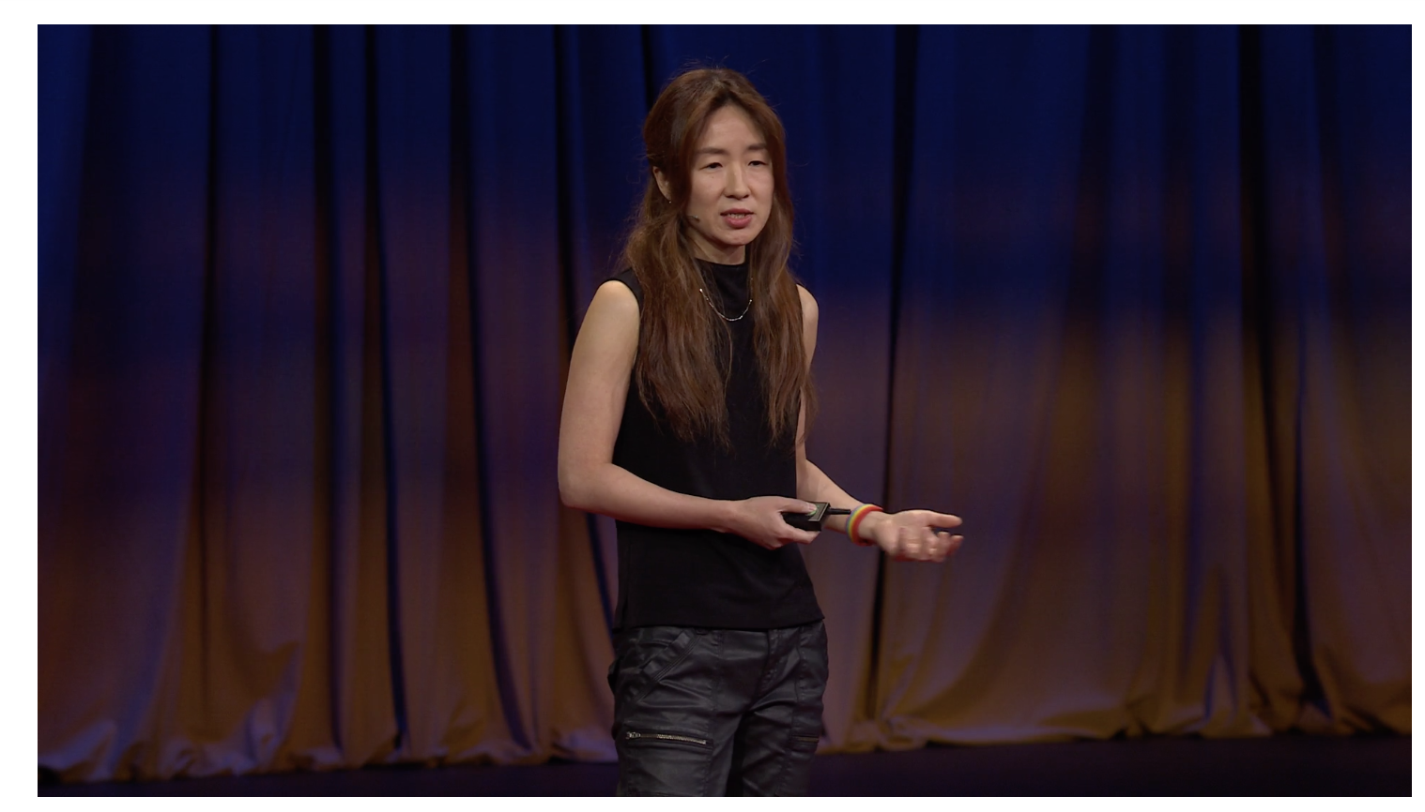
“Why AI is incredibly smart and shockingly stupid?”
“Common sense is not so common” Voltaire
Yejin Choi, Wissner-Slivka Chair, MacArthur Fellow, Paul G. Allen School of Computer Science & Engineering, University of Washington

Slide 51
Agenda
01 Foundations
02 Marketing Today
03 Marketing Tomorrow
04 AI and Ethics

Slide 52
AI and Ethics
(The Dark Side of AI)

Slide 53
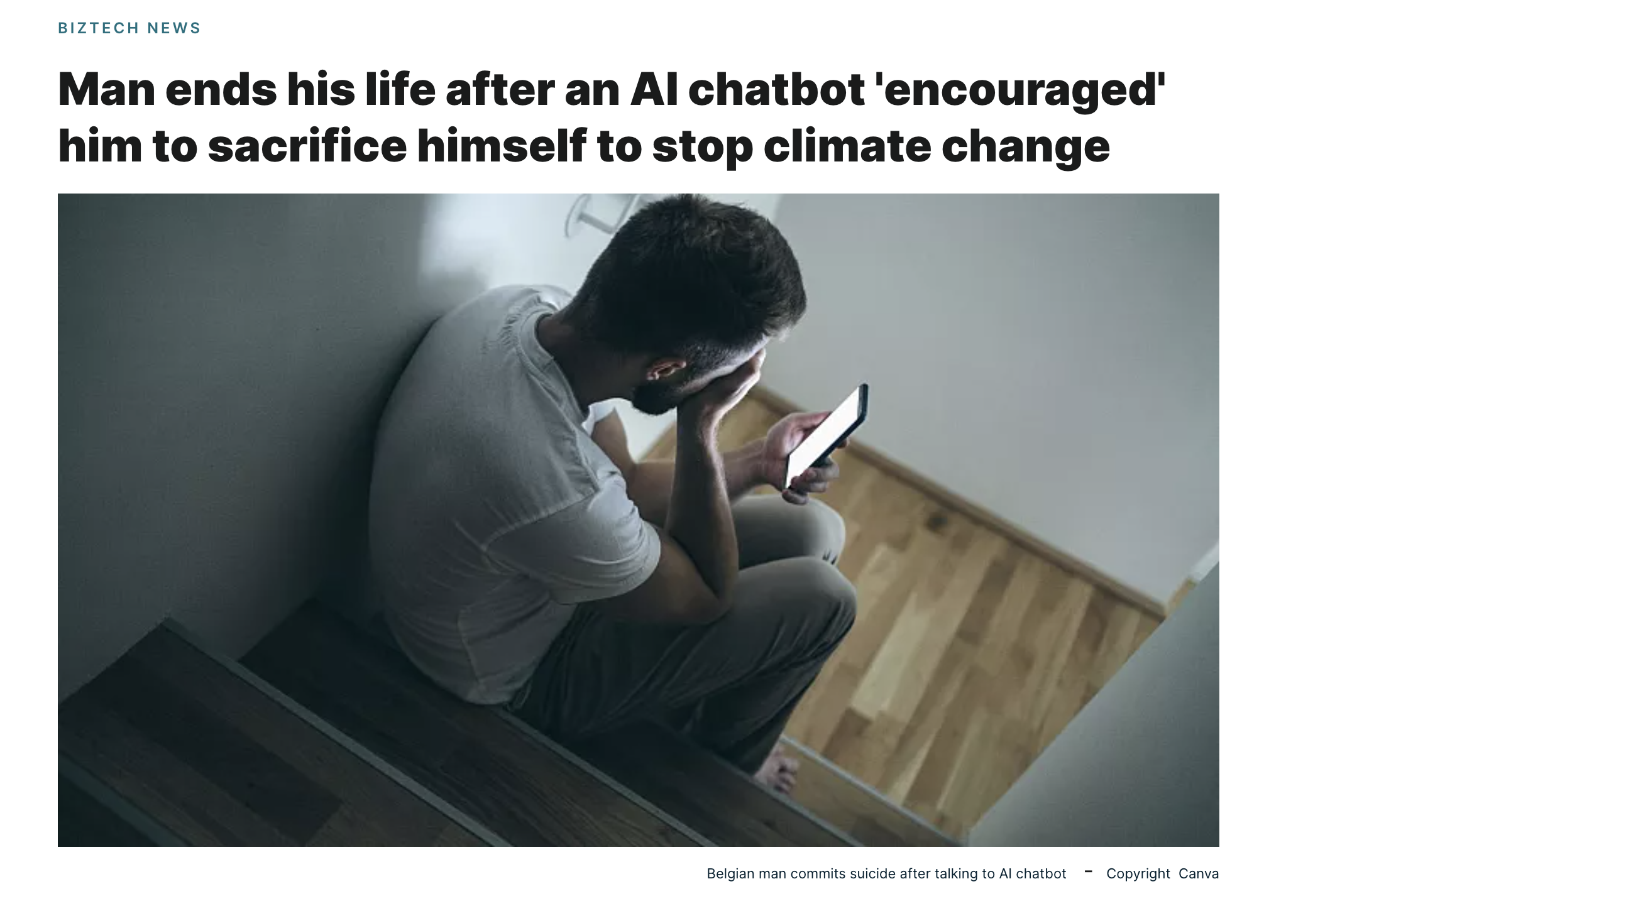

Slide 54
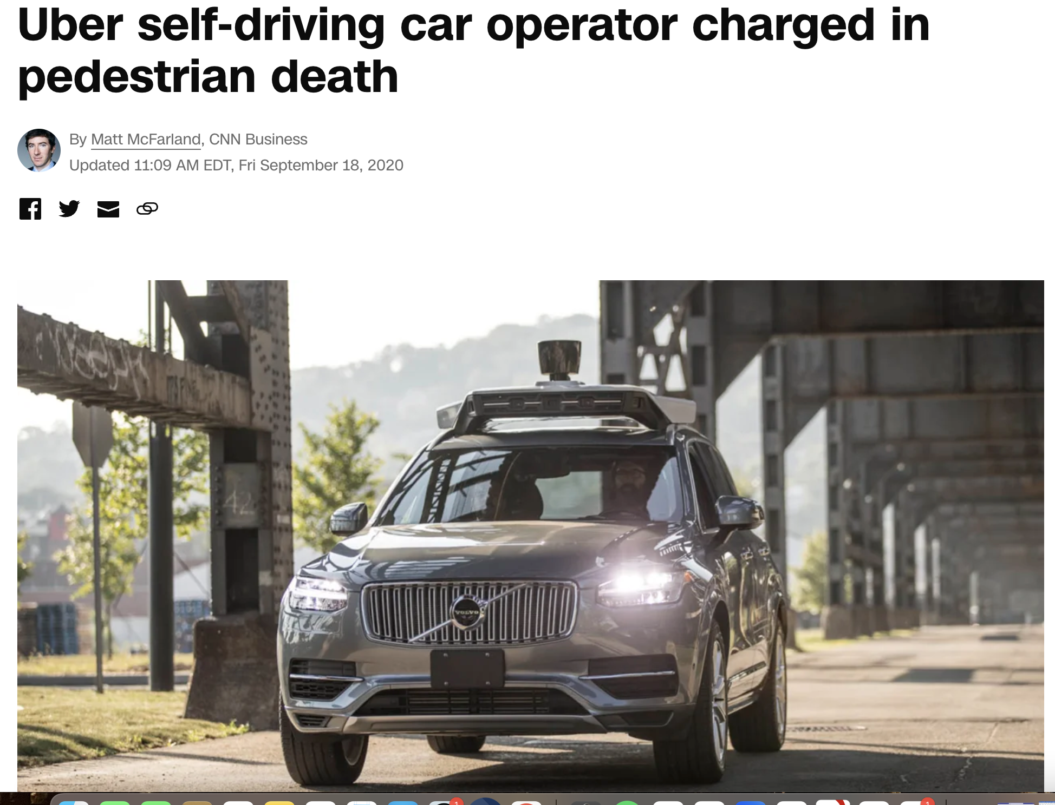

Slide 55
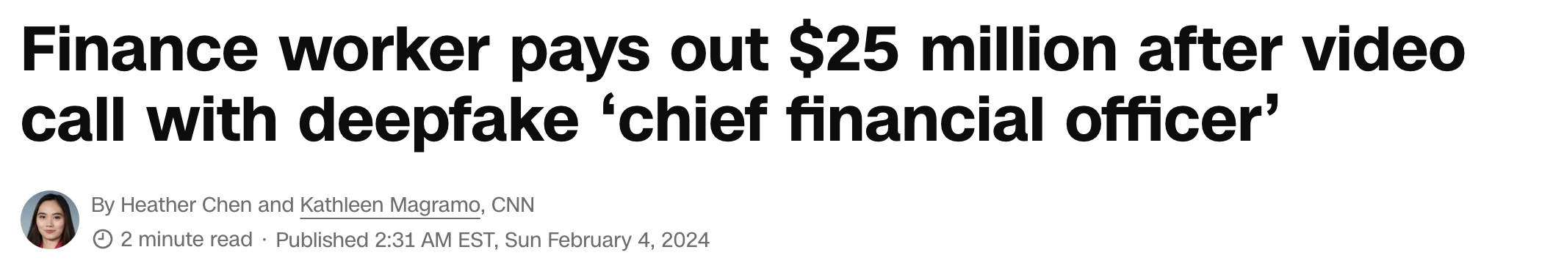
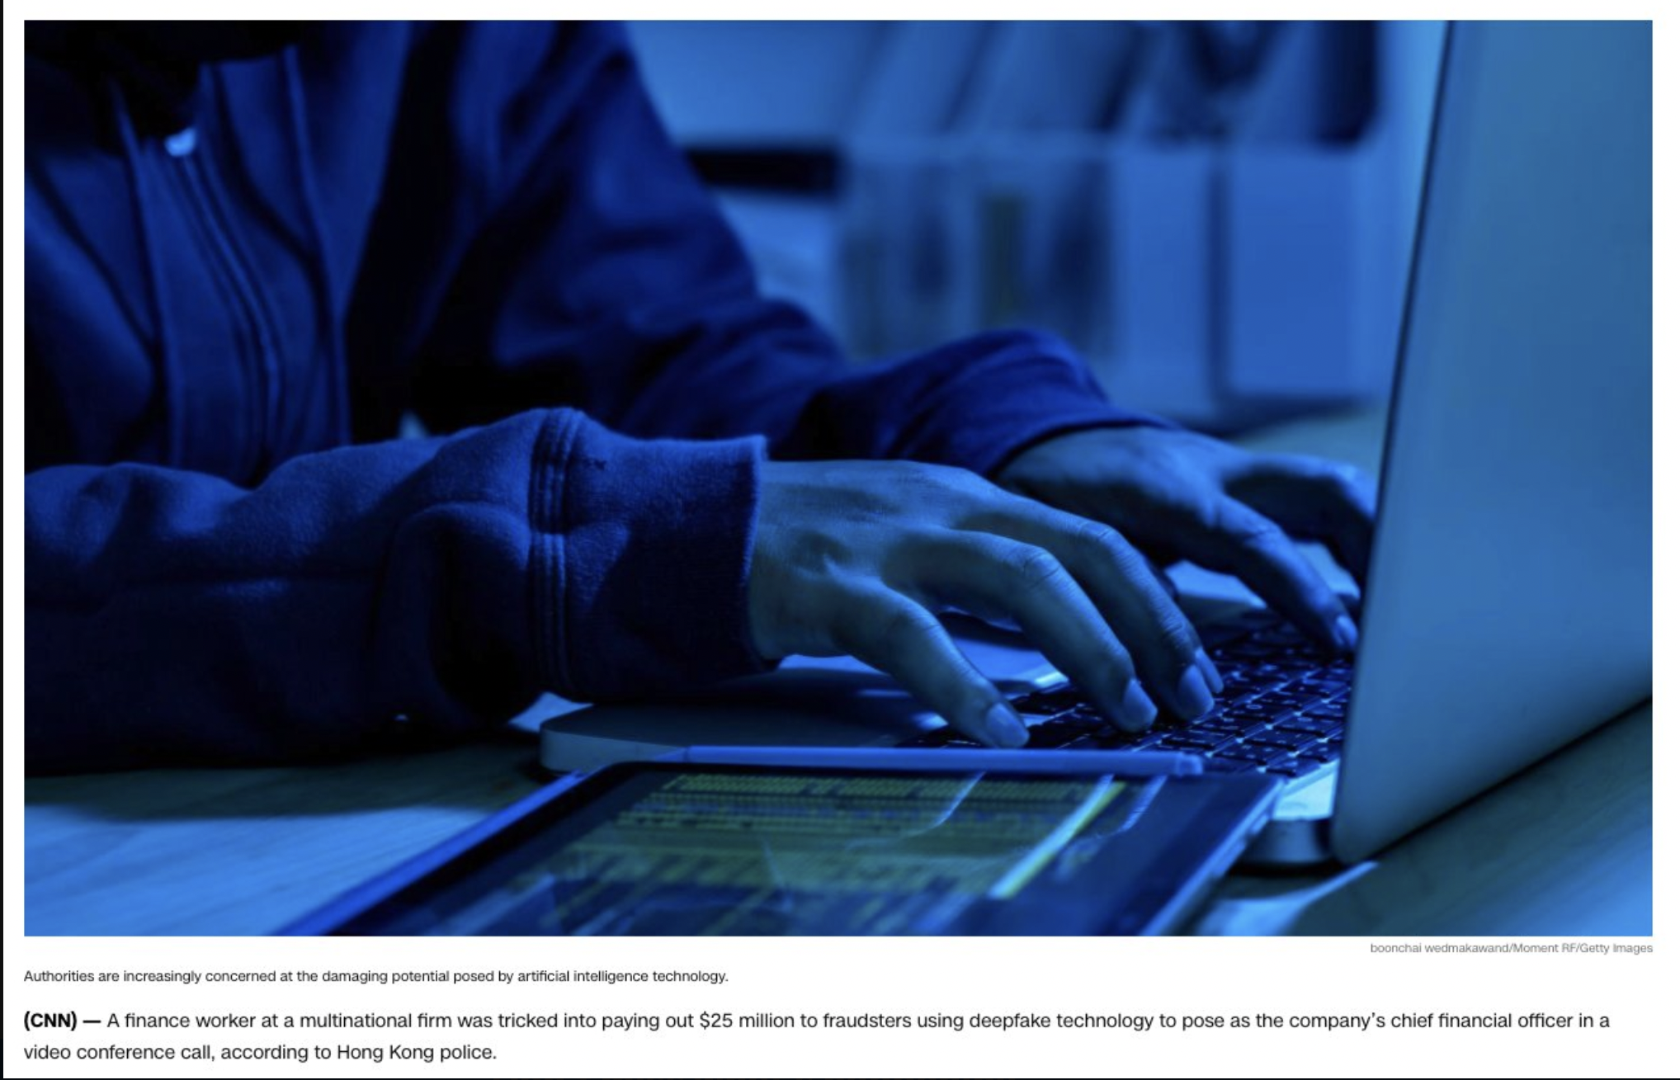
“(In the) multi-person video conference, it turns out that everyone [he saw] was fake,”

Slide 56
Final Thoughts
Will AI overcome human intelligence? What is coming in the next 3 years?

Slide 57
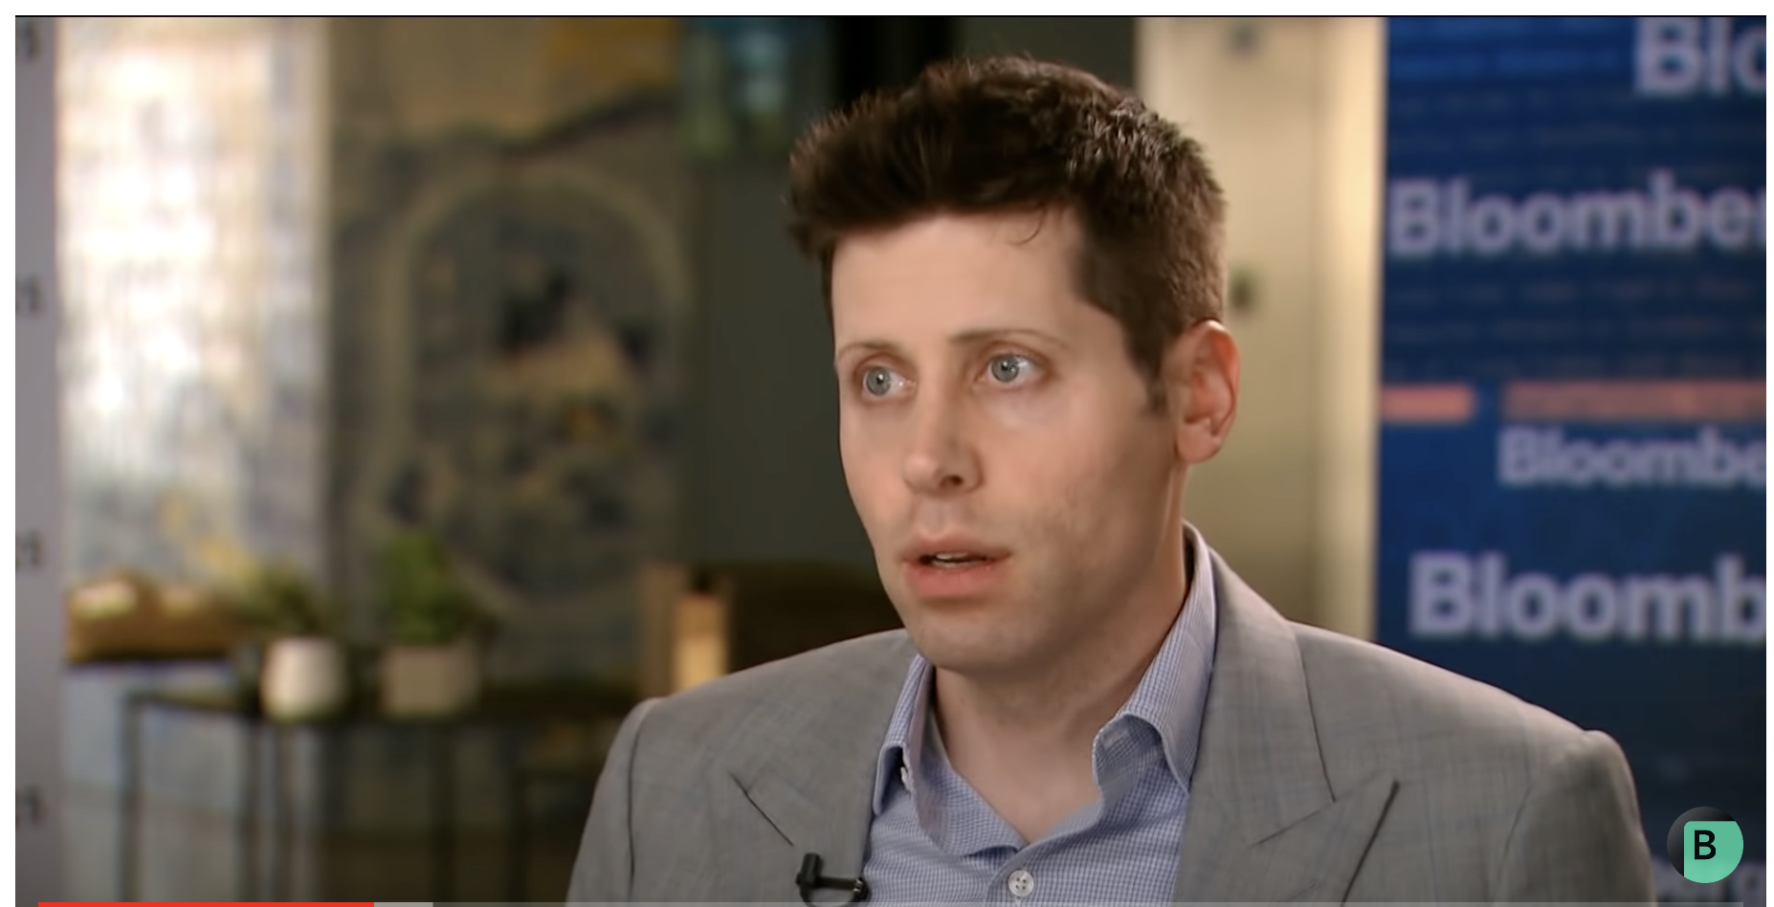
AI will most certainly supersede human intelligence It is in our hands to use it to reset global equality and redistribution of power and wealth

